Slide 1
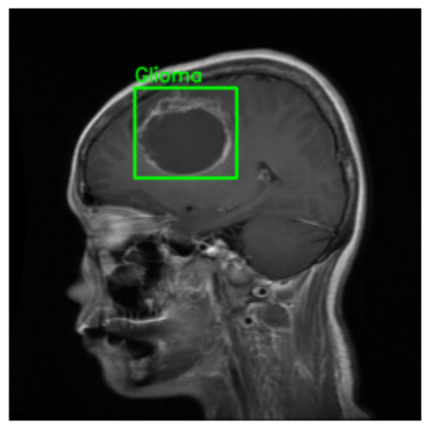
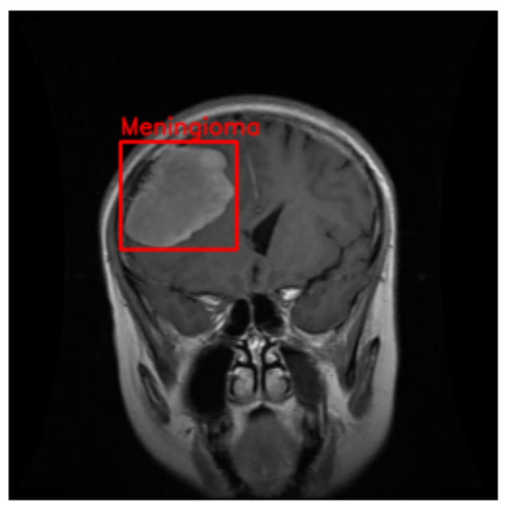
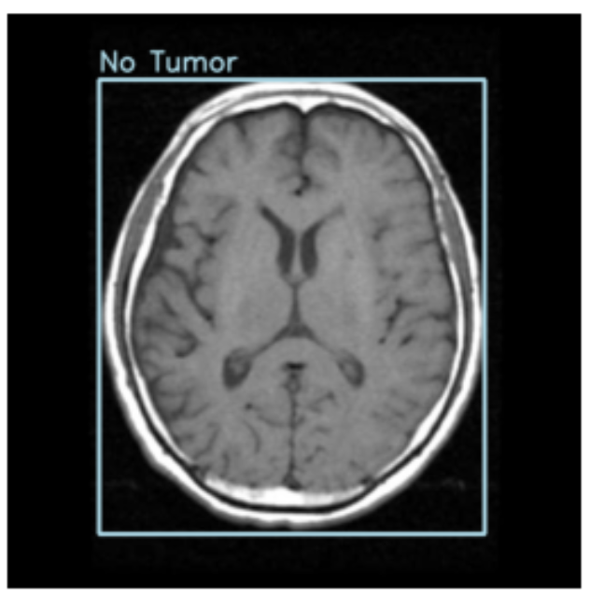
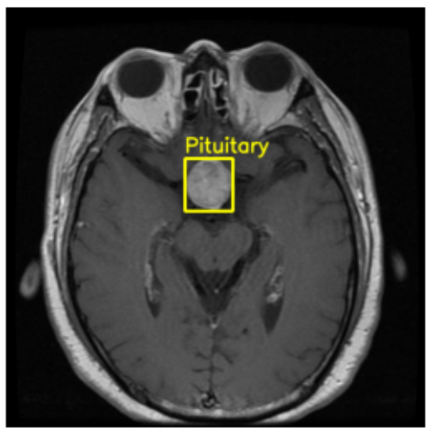
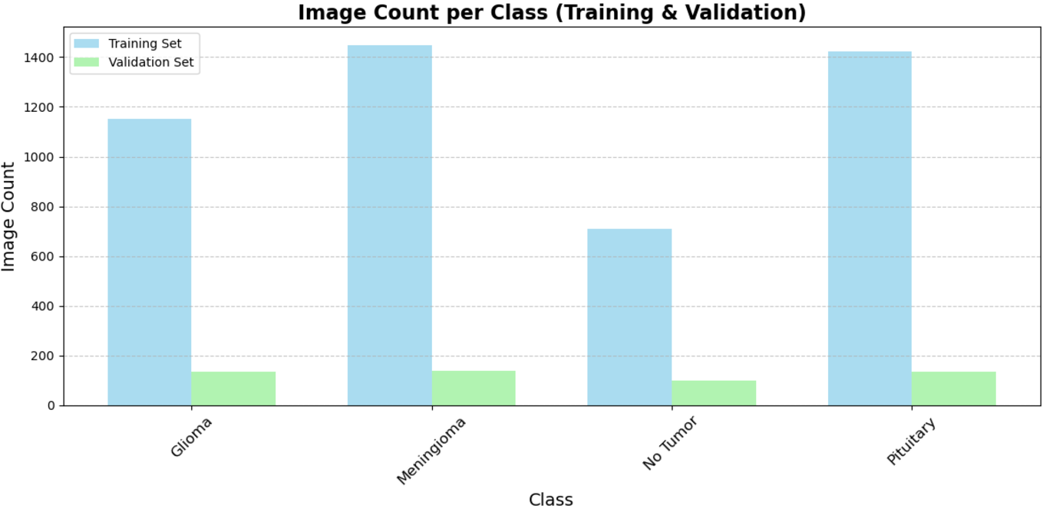
Machine Learning-Driven Brain Tumor Classification and Localization
Background
Brain tumors are critical to diagnose early for effective treatment.
MRI scans are essential in identifying and localizing tumors.
Advances in Machine Learning (ML) enable precise classification and localization of tumors, revolutionizing medical imaging.
Dataset Overview
Total Images: 5,249 high-quality MRI scans.
Classes:
Glioma
Meningioma
No Tumor
Pituitary
Data Split:
Training: 4,737 images
(1,153 Glioma, 1,449 Meningioma, 711 No Tumor, 1,424 Pituitary)
Validation: 512 images
(136 Glioma, 140 Meningioma, 100 No Tumor, 136 Pituitary)
Key Features
Annotations: YOLO format bounding boxes.
Views: Sagittal, Axial, Coronal for comprehensive brain anatomy.
Cleaned Data: Noise-free, high-quality images from multiple sources.

Slide 2
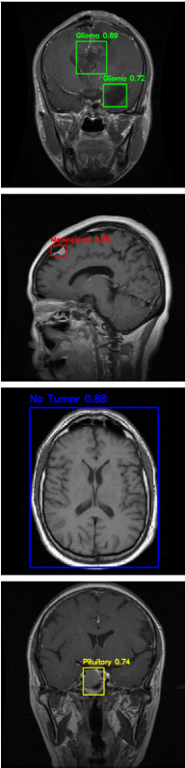
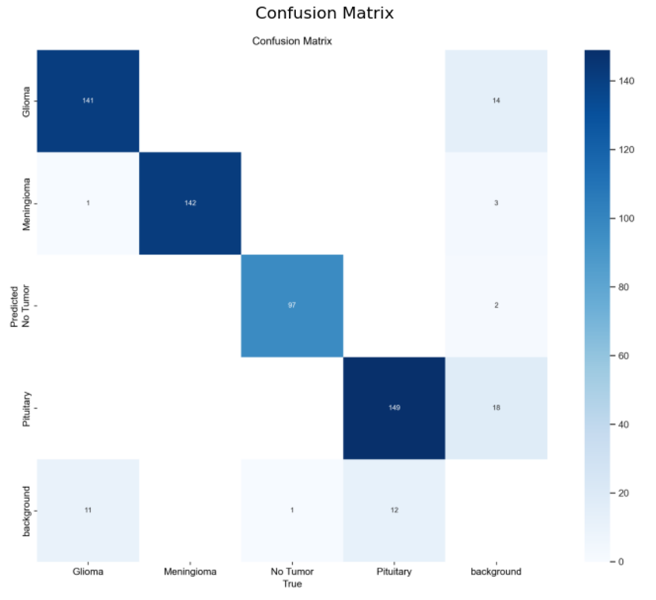
Data Preprocessing
Data Validation & Loading: Verified and loaded images with labels, handling issues gracefully.
Resizing & Mapping: Resized images to 640x640; mapped labels to bounding boxes.
Dataset Setup: Defined training/validation paths and class names in a YAML file.
YOLO11s Model Overview
YOLO Models are a family of real-time object detection architectures designed for speed and accuracy, predicting bounding boxes and class probabilities in a single forward pass.
User-Friendly: Pre-trained weights enable quick setup for object detection tasks.
Feature-Rich: Supports bounding boxes, multi-class detection, and customizable settings.
Model Summery: 319 layers, 9.43M parameters, 21.6 GFLOPs.
Overall Performance: High precision (94.6%) and recall (94.1%) across all classes with an mAP@50 of 96.4%.
Strongest Classes: "Meningioma" and "No Tumor" show near-perfect detection with precision >97% and recall >98%.
Room for Improvement: Lower mAP@50-95 for "Glioma" (76.9%) and "Pituitary" (76.3%) indicates challenges with stricter IoU thresholds.
Dataset Coverage: Evaluated on 512 images with 554 labeled instances across 4 tumor classes.

